Slide 1
Fit or Fat
Project By
Team: SVM
Matthew Velazquez(42)
Vijaya Yeruva(47)
Saria Goudarzvand(48)

Slide 2
Use Case 13 by UMKC CSEE
Use Case U13: Food Game: Junk or Healthy?
1. Classification: Junk Food? Healthy Food? (image based classification)
2. Sentiment Classification of Food Reviews: predict the score of food reviews on a scale of 1 to 5
3. Predict calories in junk food and healthy food
Write a mobile or web-based app for the food game.

Slide 3
Proposed Solution
Developed a mobile gaming application which will capture the image and send it as input to the deep learning model. Deep learning model will process the image and displays the output with name of the image, calories related to the image, and review/rating/sentiment of the image.

Slide 4
Tools Used
Android Studio
Tensorflow

Slide 5
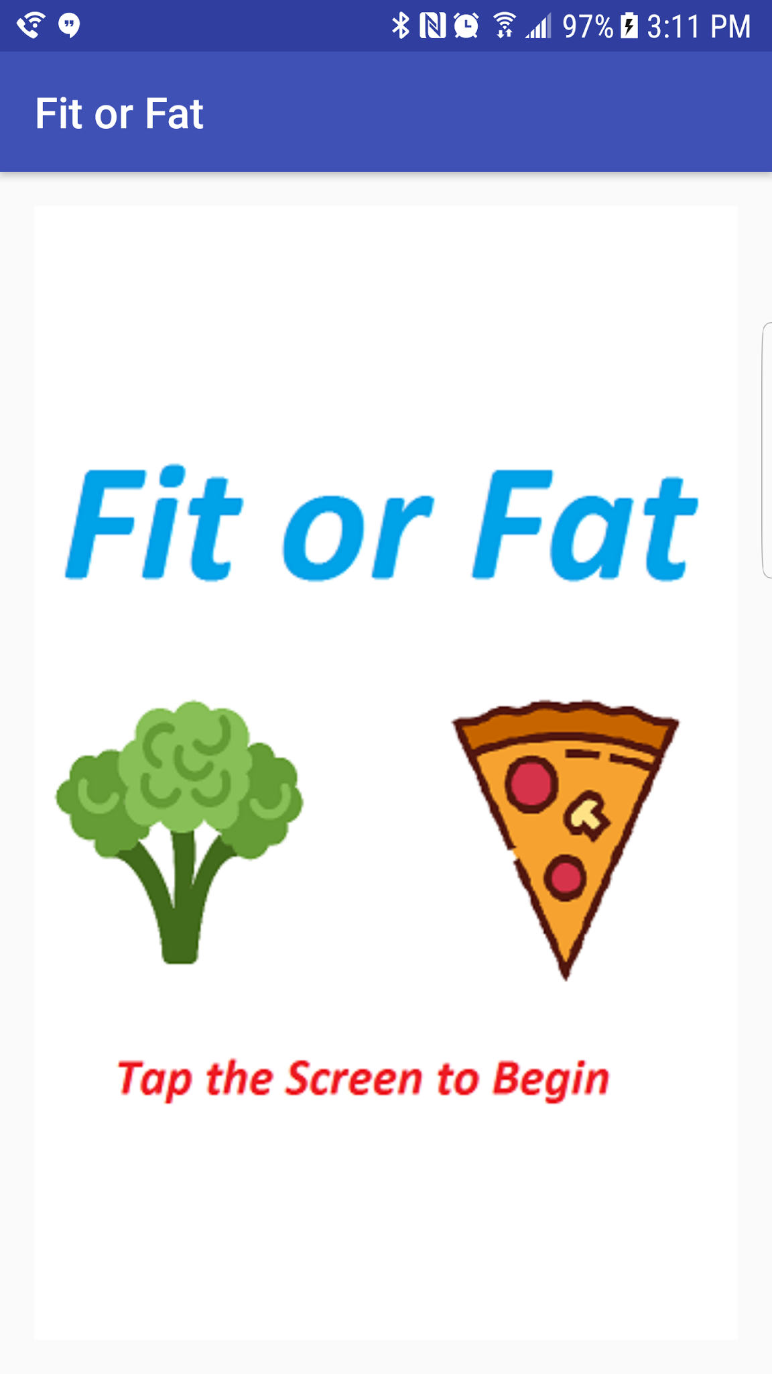
Implementation: Android Application

Slide 6
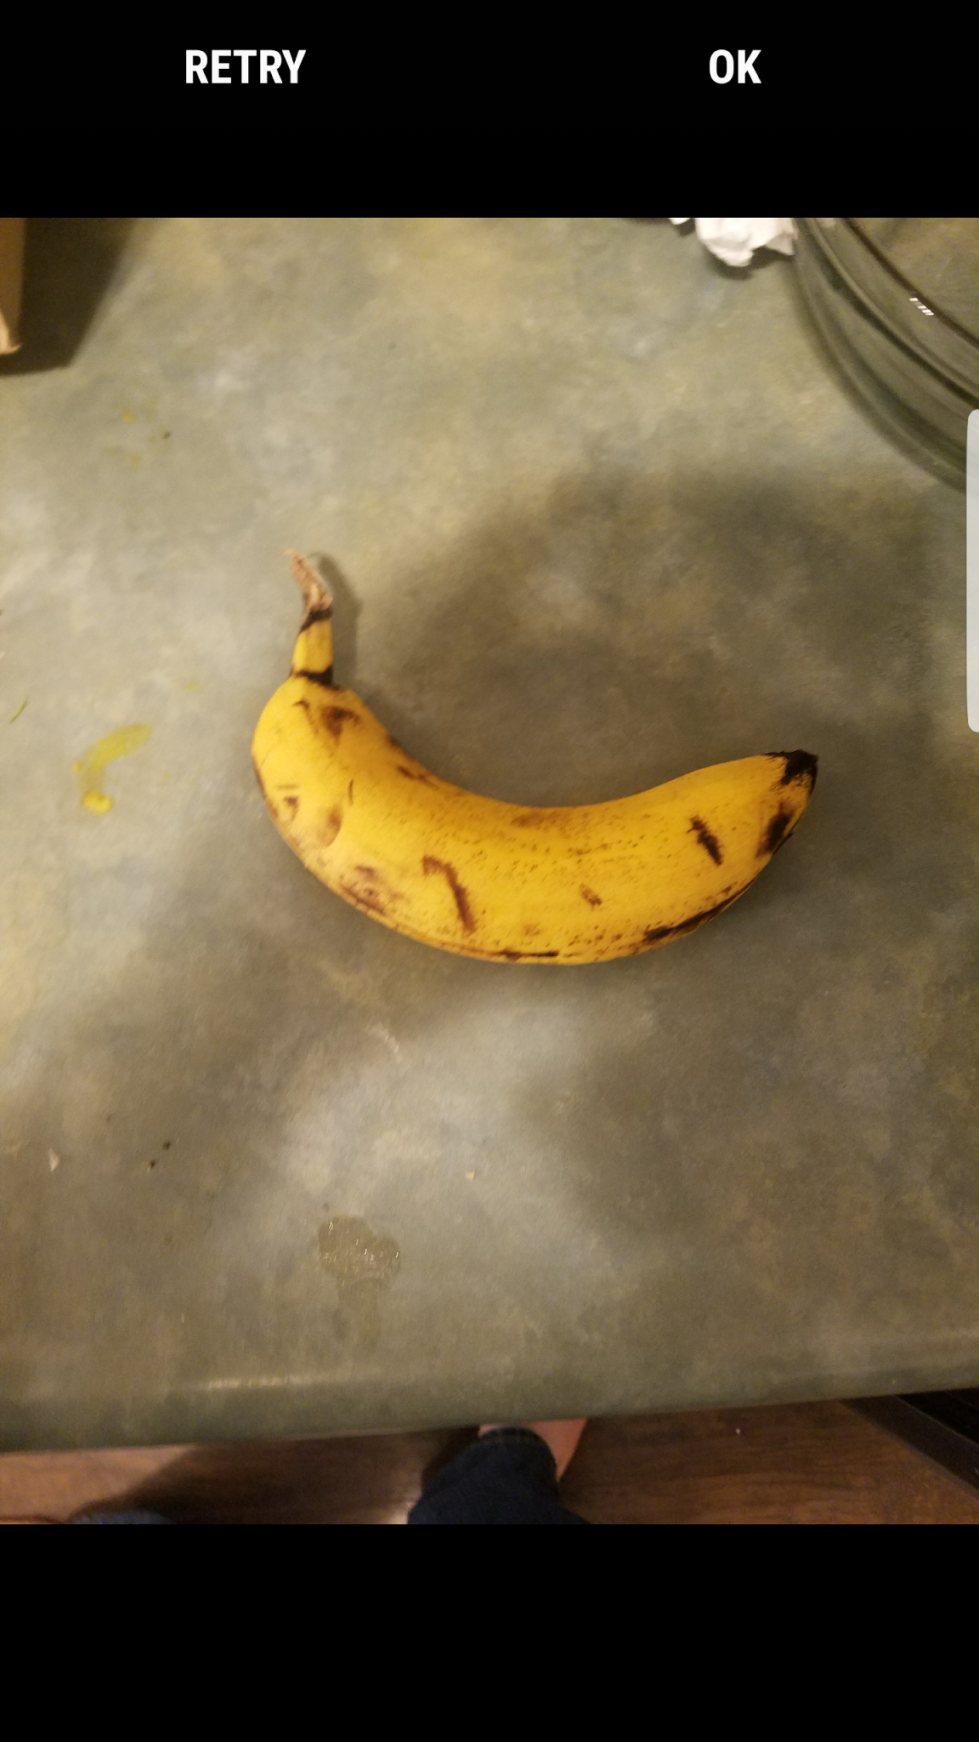
Implementation: Android Application

Slide 7
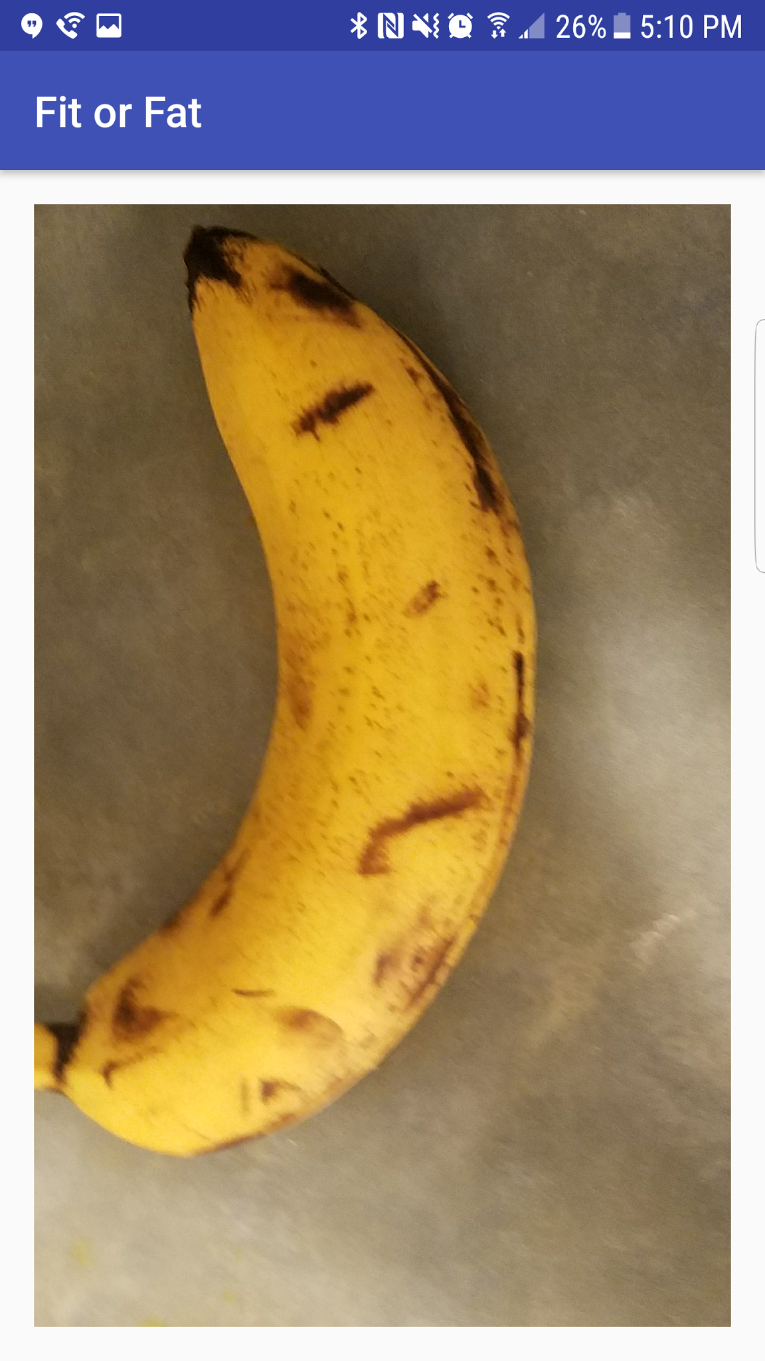
Implementation: Android Application

Slide 8
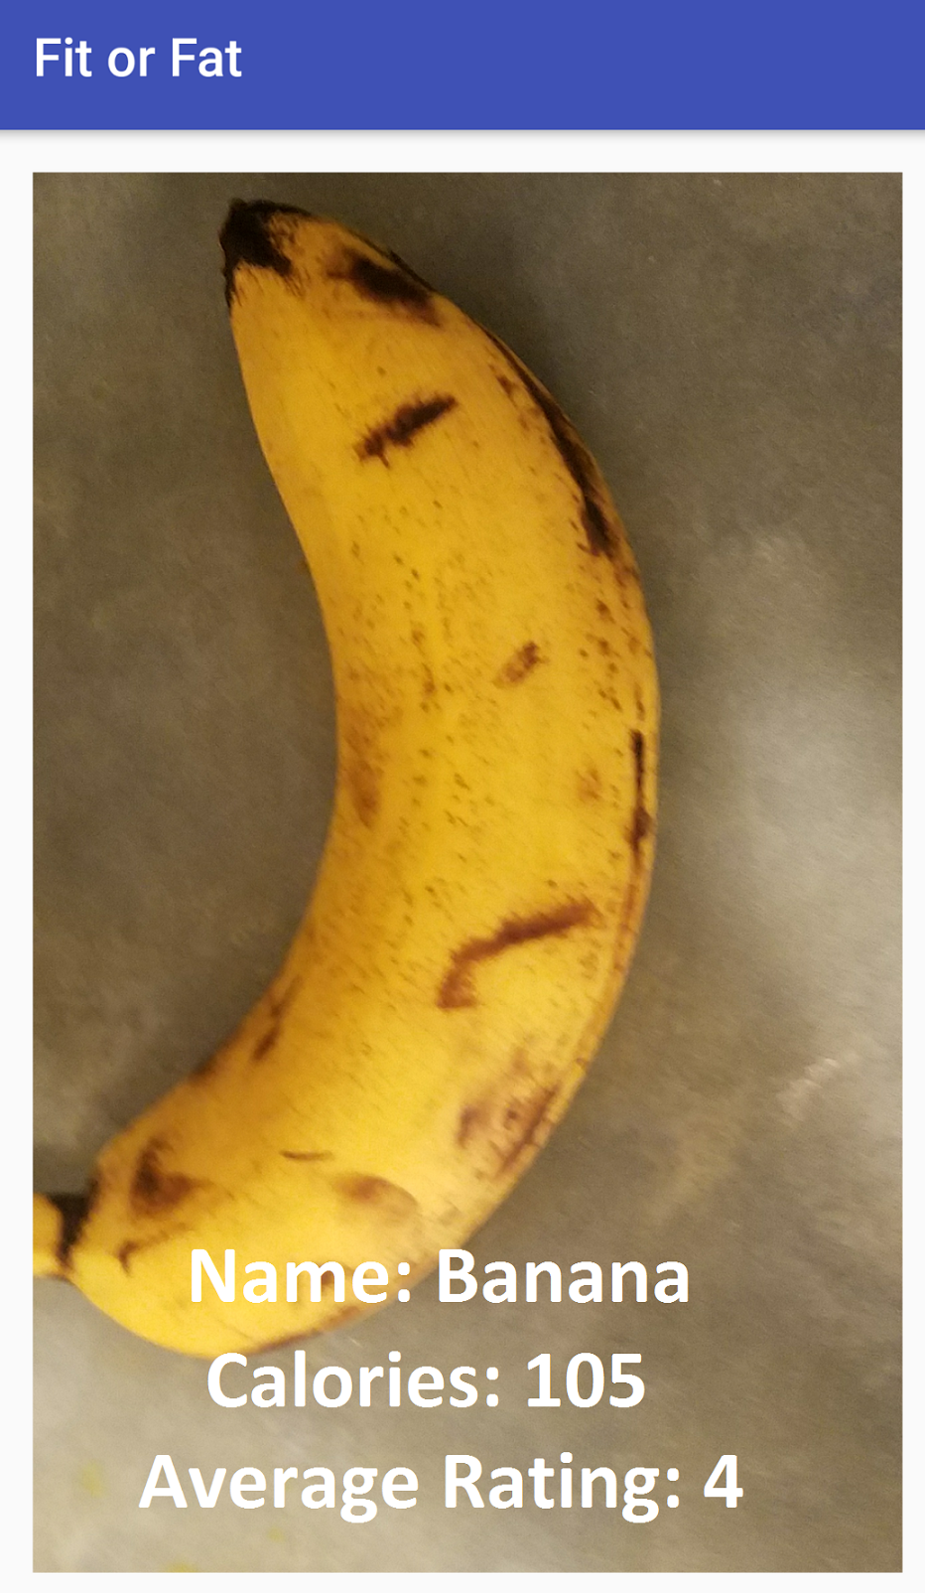
Implementation: Android Application

Slide 9
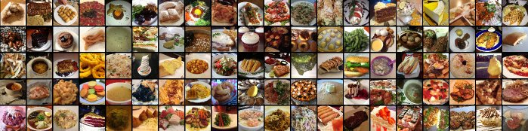
Implementation: Deep Learning Model
About Dataset: Food-101 data set
There are 101 different classes of food, with 1000 labeled images per class available for supervised training

Slide 10
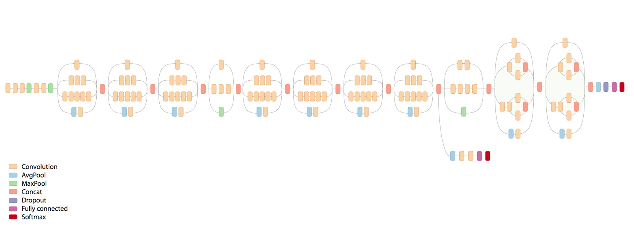
Implementation: Deep Learning Model
About Model: Customized Inception Model
Retrained the final layer of the Inception Model with Food-101 data set.

Slide 11
Implementation: Deep Learning Model
About Accuracy:
Achieved 64.3% training accuracy

Slide 12
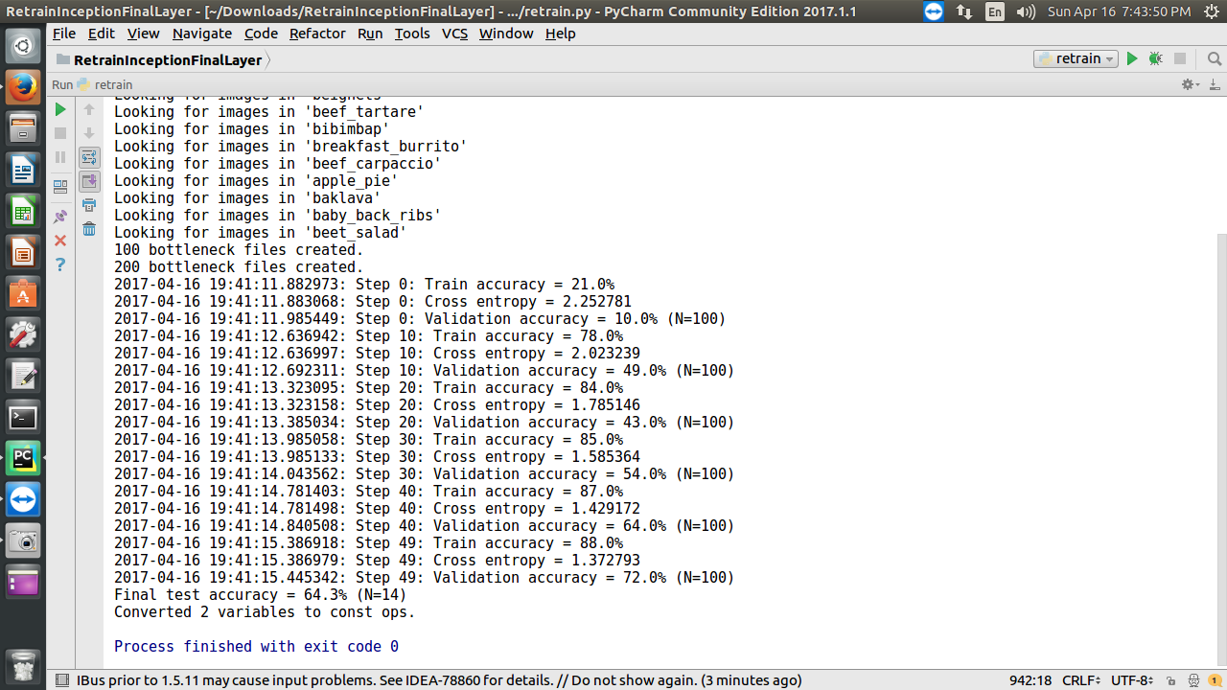
Implementation: Deep Learning Model

Slide 13
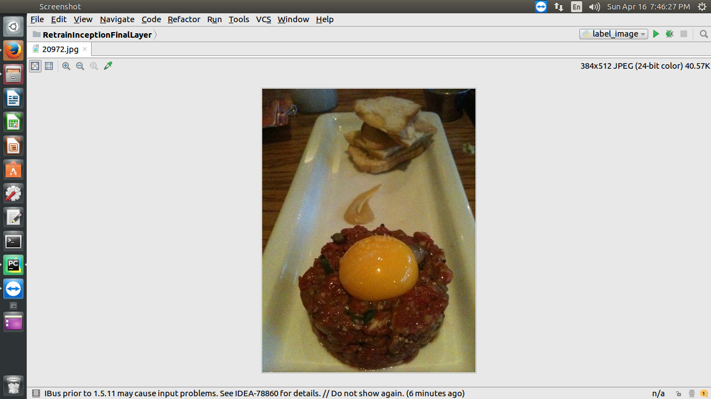
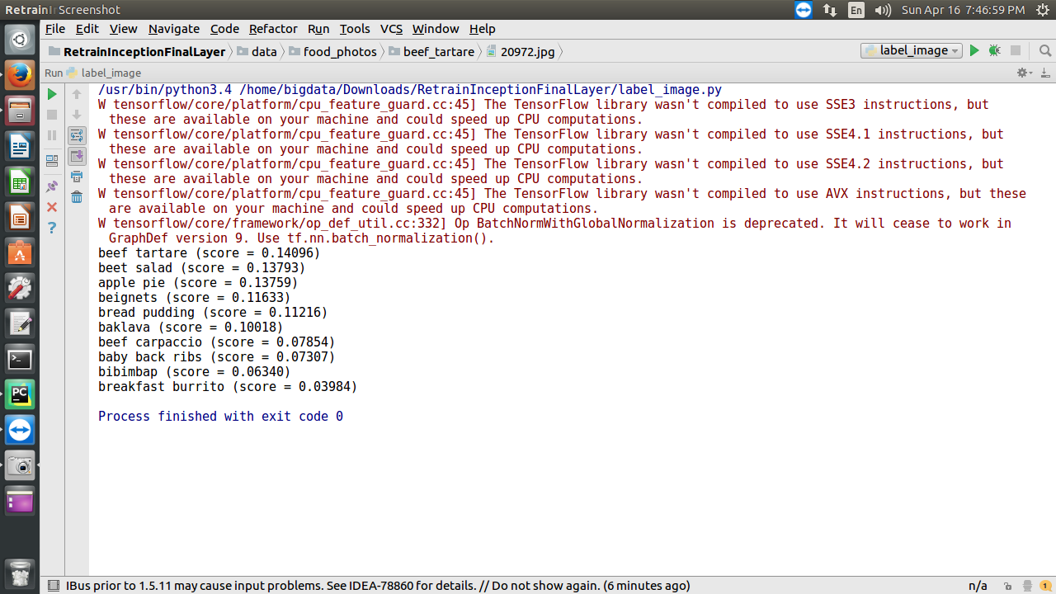
Implementation: Deep Learning Model
Example
Image: Beef Tartare
Prediction: Beef Tartare (score = 0.14096)

Slide 14
References:
https://docs.google.com/spreadsheets/d/16PWHWi6wlLtG9N0MYpNx9DYU0VZ3schWWrO_kbJEIbg/edit#gid=636461611
https://www.youtube.com/watch?v=44UPL9ABzng
https://github.com/stratospark/food-101-keras
https://snap.stanford.edu/data/web-FineFoods.html

Slide 15
THANK YOU !

